Slide 1


Using the 2016 National Competency Standards Framework for Pharmacists in Australia
to meet the Pharmacy Board
of Australia’s CPD
registration standard
Notes:
This presentation has been developed to provide you with an introduction to:
your professional obligations to practise safely and effectively
your registration responsibilities in relation to using the 2016 National Competency Standards Framework for Pharmacists in Australia; and
step through the tools and resources available to support you in meeting the Pharmacy Board of Australia’s Continuing Professional Development Registration Standard.

Slide 2
The professional responsibility of all health practitioners
To practise safely and effectively, with the care of patients or clients their first concern
A lifelong commitment to:
  recognising and working within the limits of their competence and scope of practice
  keeping their skills and knowledge up-to-date
  reflecting regularly on whether they are practising effectively
  refining and developing their judgement as they gain experience
  when moving into a new area of practice, ensuring they have achieved competency in that area
Code of conduct for registered health practitioners. Pharmacy Board of Australia; 2010
Notes:
All health practitioners have a professional responsibility to practise safely and effectively, with the care of patients or clients their first concern. There is a community expectation that health practitioners commit to:
recognising and working within the limits of their competence and scope of practice;
keeping their skills and knowledge up-to-date;
reflecting regularly on whether they are practising effectively;
refining and developing their judgement as they gain experience; and
when moving into a new area of practice, ensuring they have achieved competency in that area.
Reference: Code of conduct for registered health practitioners. Pharmacy Board of Australia; 2010.

Slide 3

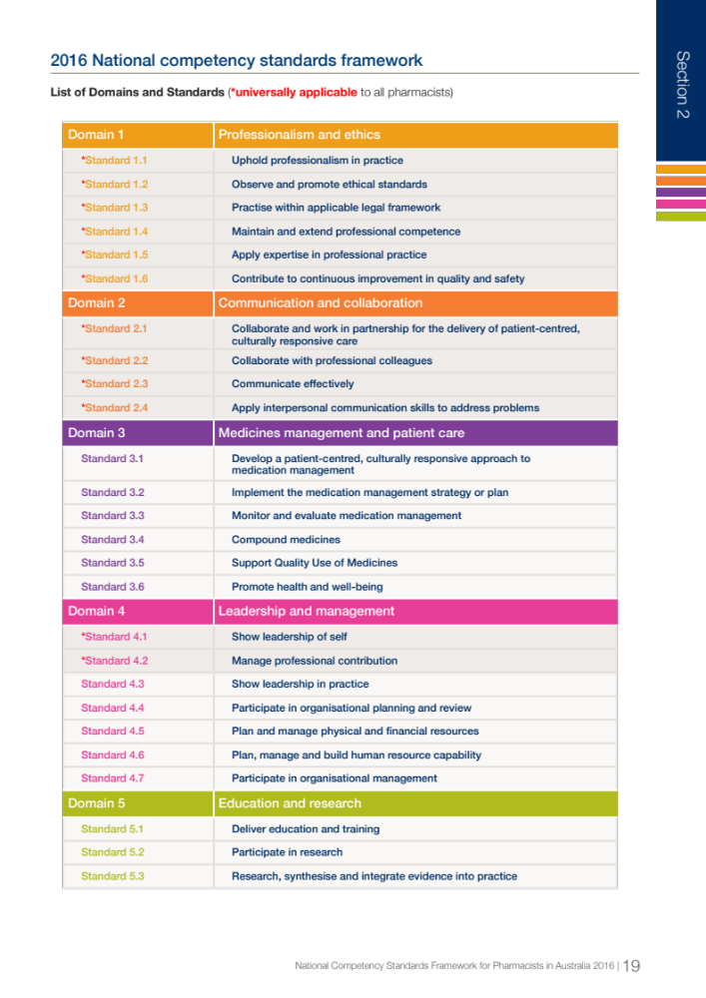
Notes:
The 2016 National competency standards framework for pharmacists in Australia has been designed to support you meet this professional responsibility.

Slide 4
Your registration requirement
Use the National Competency Standards Framework for Pharmacists in Australia each year to:
Identify the competency standards relevant to your scope of practice (the role you perform and services you provide), as well as any proposed changes to your practice
Identify professional development needs relevant to those competency standards, and take action to address those needs
Registration standard: Continuing professional development. Pharmacy Board of Australia; 2015
Notes:
Using the Framework is also a registration requirement.
Each year, pharmacists seeking to renew their registration must meet the Pharmacy Board of Australia’s registration standard for continuing professional development (CPD). This includes using the Framework to:
Identify the competency standards relevant to the role you perform and services you provide, that is, your scope of practice, as well as any proposed changes to your practice; as well as to
Identify professional development needs relevant to those competency standards, and take action to address those needs.
Reference: Registration standard: Continuing professional development. Pharmacy Board of Australia; 2015.

Slide 5
Your scope of practice
Every pharmacist has their own scope of practice which includes…
‘any role, whether remunerated or not, in which the individual uses their
skills and knowledge as a pharmacist in their profession’
and
‘not restricted to the provision of direct clinical care. It also includes working in a direct non-clinical relationship with clients; working in management, administration, education, research, advisory, regulatory or policy development roles; and any other roles that impact on safe, effective delivery of services in the profession’
Your CPD should reflect your scope of practice
Notes:
Every pharmacist has their own scope of practice and your CPD should reflect this.
As a pharmacist, you can use your expertise in medicines to optimise health outcomes and minimise medication misadventure through working in many different types of roles, in different kinds of services and in an ever-changing environment.
Every pharmacist has their own scope of practice. Your scope encompasses all roles held, whether remunerated or not, in which you use your skills and knowledge as a pharmacist. Practice is not restricted to the provision of direct clinical care. It also includes working in a direct, non-clinical relationship with clients; working in management, administration, education, research, advisory, regulatory or policy development roles; and other roles that impact on safe, effective delivery of services in the profession. Your scope of practice is time-sensitive and dynamic, and may be across multiple settings.

Slide 6
Make it meaningful
The Framework can be used to:
support you to ensure you are maintaining the skills expected for your scope of practice
support your growth, development and change in the role you perform and the services you provide
Notes:
Using the Framework to plan your CPD is a requirement for registration, but it can also be a meaningful and beneficial exercise to go through.
It can support you to ensure you are maintaining the skills expected for your role
This is a community expectation.
Not all competency standards in the Framework will be relevant to every scope of practice. You will need to create your own profile by selecting those that apply to the current role you perform and the services you provide.
Understanding the skills expected in your own practice will allow you to systematically reflect on whether you are maintaining them.
This is also a requirement for registration. In the interests of public safety, the Pharmacy Board of Australia requires you to do this each year as the basis for planning your continuing professional development (CPD).
It can also support your growth, development and change in the role you perform and the services you provide
The way health care is delivered is changing. The population is changing, health needs are changing, technology is advancing, and financial sustainability is at risk.
Pharmacists need to be innovative in how they contribute to healthcare in meeting the current and future challenges our health care system is facing.
At an individual level, these competency standards can help you reflect on how you can extend and advance your current role and the services you provide.
They are also a mechanism by which the pharmacy profession as a whole can demonstrate the capability of pharmacists to undertake roles that meet public need, as seen recently with the introduction of pharmacists administering vaccines.

Slide 7
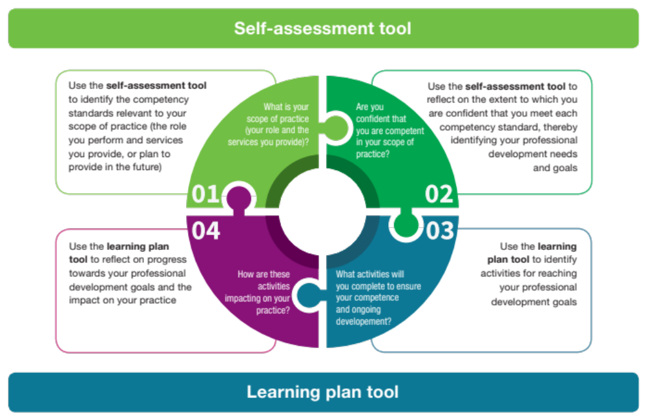
The process
Notes:
This image provides you with an overview of the process you should follow.
To use the Framework:
Start by considering your scope of practice… all the roles you perform and the services you provide, or plan to provide in the future. [indicate top left quadrant]
Then consider whether you are confident that you are competent in your scope of practice in order to set some professional development goals [indicate top right quadrant]
Then consider what activities you can complete to achieve those professional development goals [indicate bottom right quadrant]
Finally consider how those activities are impacting on progress towards your goals and how they are impacting on your professional practice [indicate bottom left quadrant]
We’ll look at this process in more detail, along with:
some tools to guide you through documenting the process; and
case studies to show you how different pharmacists have approached this.

Slide 8
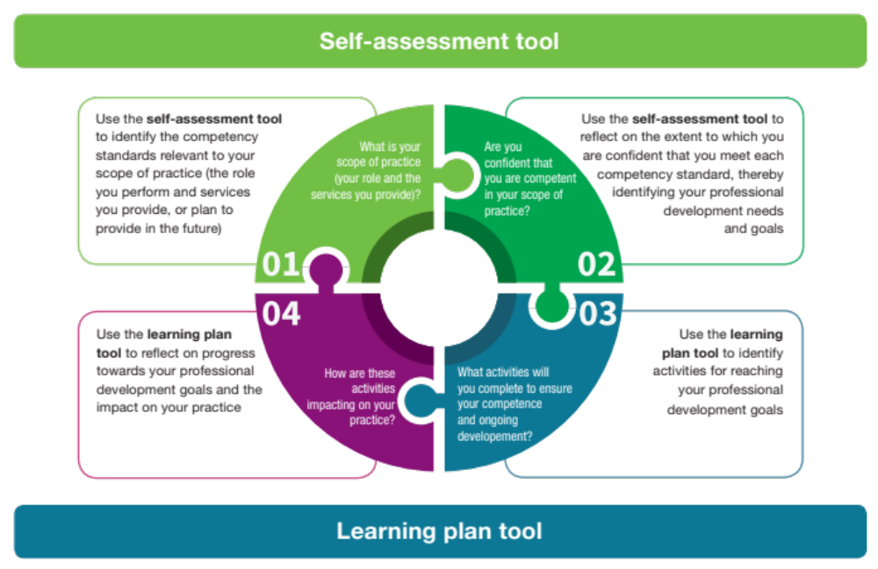
The process
Notes:
There are 2 key tools that have been developed to step you through using the Framework in a way that meets the Pharmacy Board’s CPD Registration Standard:
A Self-assessment tool, and
A Learning plan tool.
(Note: the use of these tools is not mandatory. You may use other tools, such as ones provided by your professional association.)
Let’s start with looking at using the self-assessment tool for these first 2 steps

Slide 9


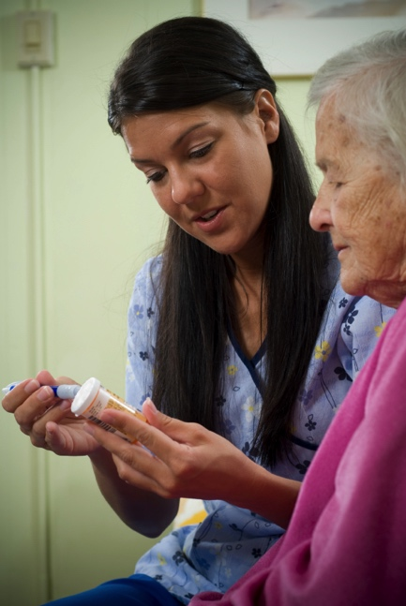

Self assessment
Step 1
Identify the competency standards relevant to
your scope of practice
Notes:
The first step is identifying the competency standards relevant to your scope of practice
You need to start by describing your scope of practice:
The Pharmacy Board defines this as any role, whether remunerated or not, in which you use your skills and knowledge as a pharmacist. This is not restricted to the provision of direct clinical care. This could encompass, as a minimum, your roles (e.g. area of responsibility and accountability, tasks, authority), work settings, services provided in work settings and geographic profile.
You should ensure you describe all areas in which you practice, not just your primary area of practice.
Your Curriculum Vitae may describe this adequately and can just be referred to.
You should also identify any roles, services and/or work settings in which you plan to practise in the future.
Let’s see how some of the pharmacists from our case studies have completed this step.

Slide 10

Case 1 – Mary
Current scope: I work full-time as a pharmacist employee in a community pharmacy. My roles include dispensing and counselling of patients, providing primary healthcare advice and professional services.
Future scope: The pharmacy will be introducing a vaccination service within the next year. I will be expected to take some leadership with the implementation of the service, which will include developing and implementing procedures, as well as ensuring staff are appropriately trained and supervised.
Notes:
When Mary describes her current scope of practice, she identifies that she works full-time as a pharmacist employee in a community pharmacy. She describes her roles as including dispensing and counselling of patients, providing primary healthcare advice and professional services.
She also looks to the future, identifying that the pharmacy is introducing a vaccination service within the next year, and that she will be expected to take some leadership with the implementation of the service. This will include developing and implementing procedures, as well as ensuring staff are appropriately trained and supervised.

Slide 11

Case 2 – Aron
Current scope: I work in a large tertiary hospital, primarily in the cardiology ward, but also one day a week on-call in the emergency department. Roles include dispensing medicines, reviewing medication charts, patient counselling, monitoring of prescribing patterns, developing prescribing guidelines, and coordinating and monitoring clinical trials. Our hospital is participating in a national project to improve health outcomes for Aboriginal and Torres Strait Islander peoples presenting with acute coronary syndromes. I also have an adjunct role lecturing at the university.
Future scope: I am to be rostered to an area in complex cardiac cases in the near future.
Notes:
When Aron describes his current scope of practice, he identifies that he works in a large tertiary hospital, primarily in the cardiology ward. He also notes that he works one day a week on-call in the emergency department. He identifies his roles as including dispensing medicines, reviewing medication charts, patient counselling, monitoring of prescribing patterns, developing prescribing guidelines, and coordinating and monitoring clinical trials. He notes that his hospital is participating in a national project to improve health outcomes for Aboriginal and Torres Strait Islander peoples presenting with acute coronary syndromes, and that he has an adjunct role lecturing at the university.
When Aron looks to the future, he identifies that he will start being rostered to an area in complex cardiac cases.

Slide 12

Case 3 – Sierra
Current scope: I work as a locum pharmacist in regional and rural areas across NSW and Qld.
In community pharmacies, I have roles such as dispensing, providing primary healthcare advice and other professional services (MedsCheck, opioid replacement therapy) and counselling patients.
I also provide pharmacy services support to Aboriginal Medical Services.
I am an accredited pharmacist and perform Home Medicines Reviews and Residential Medication Management Reviews.
Future scope: Nothing different planned
Notes:
When Sierra describes her current scope of practice, she identifies that she works as a locum pharmacist in regional and rural areas across NSW and Queensland. She describes her roles in community pharmacies as including dispensing, counselling patients, and providing primary healthcare advice and other professional services, such as MedsCheck and opioid replacement therapy.
Sierra also identifies that she provides pharmacy services support to Aboriginal Medical Services, and, as an accredited pharmacist, she performs Home Medicines Reviews and Residential Medication Management Reviews.
Looking to the future, Sierra does not identify any changes in her scope.

Slide 13

Case 4 – Lee
Current scope: I have a proprietary interest in one pharmacy. The pharmacy offers dispensing and counselling of patients, the provision of primary healthcare advice and professional services. It is registered for 6CPA medication adherence programs (staged supply, dose administration aids, and clinical interventions) and is also involved in the Pharmacy Diabetes Screening Trial.
Future scope: I will cease being the Pharmacist in Charge at the end of the month, not dispensing in the pharmacy any more but retaining my ownership and management role.
Notes:
When Lee describes his current scope of practice, he identifies that he has a proprietary interest in one pharmacy. He notes that his pharmacy offers dispensing and counselling of patients, the provision of primary healthcare advice and professional services. It is registered for 6CPA medication adherence programs - staged supply, dose administration aids, and clinical interventions - and is also involved in the Pharmacy Diabetes Screening Trial.
When he looks to the future, he identifies that he will cease being the Pharmacist-in-Charge at the end of the month, not dispensing in the pharmacy any more, but retaining his ownership and management role.

Slide 14
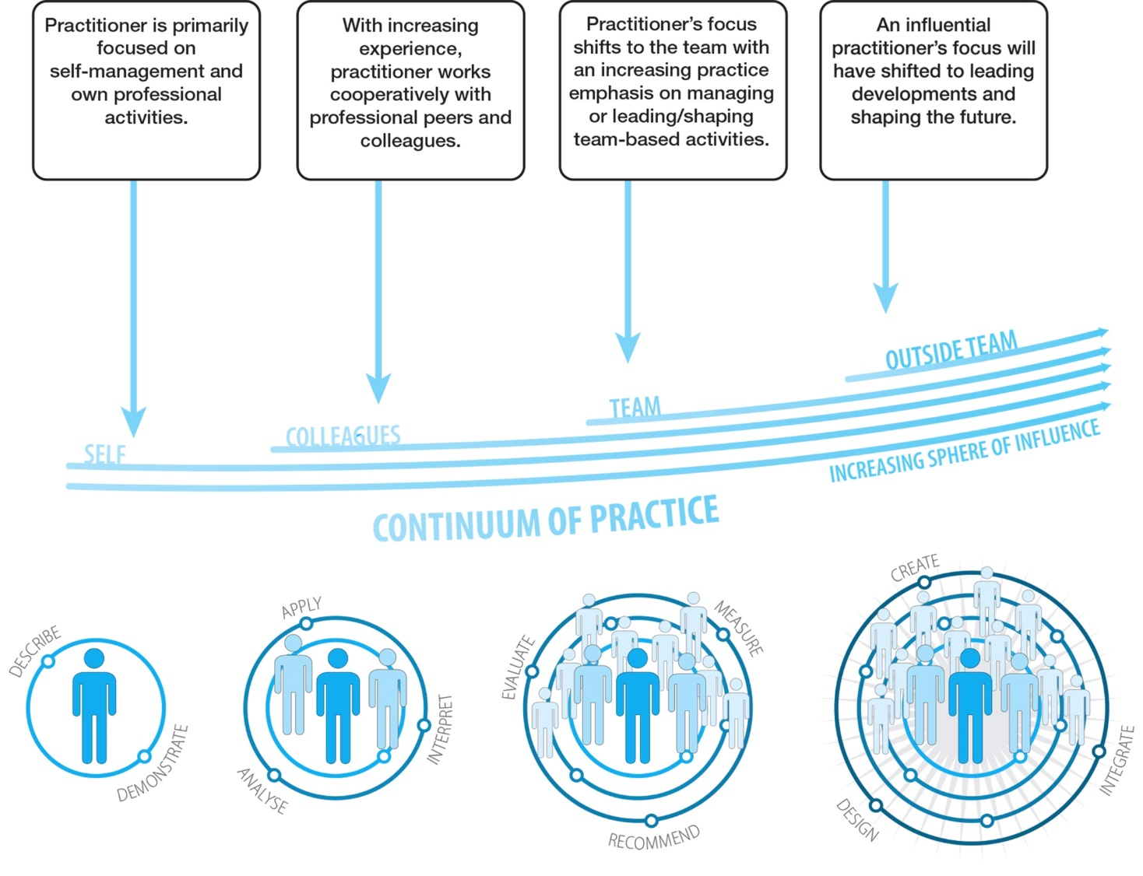
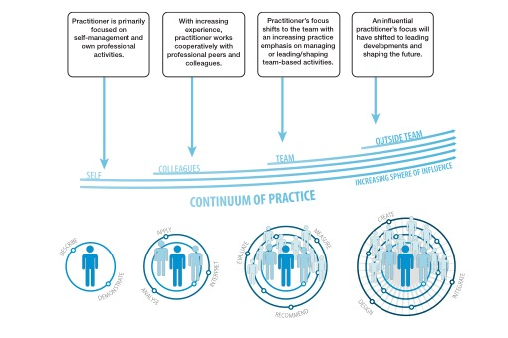
Your scope of practice changes over time
Notes:
Remember, however, that your scope of practice is not static.
This is partly because you change.
From initial registration as a pharmacist, you enter a career-long process of professional development as a result of education, training and experience.
Initially you focus on your own professional activities and self-management. This progresses to a focus on working cooperatively with professional peers and colleagues, which may then shift to managing and leading and shaping the team’s activities. Your focus may eventually shift beyond your team, leading development in and shaping the environment and the future for the profession.
Also, it is because the practice of pharmacy changes.
This occurs both as the profession matures, and also as the Australian health care system and society evolves and changes.
Examples of where we see this is with pharmacists now able to administer medicines (e.g. vaccines), and also with them increasingly working in a more diverse range of environments, such as general practices and community services.
This means that the competency standards that apply to your scope of practice will also change over time.

Slide 15
Understanding the Framework
An * means this competency is relevant in ALL scopes of practice.
For the other competencies, you need to determine whether they are relevant to your scope of practice.
Notes:
Before using the Framework to identify the competency standards relevant to your scope of practice, it is first useful to understand how the Framework is structured.
The Competency Standards are grouped into 5 Domains: Professionalism and ethics; Communication and collaboration; Medicines management and patient care; Leadership and management; Education and research
An * next to a standard denotes those competency standards that apply to the scopes of practice of ALL pharmacists. For those standards without an * , they may or may not apply to you, depending on your scope of practice.

Slide 16
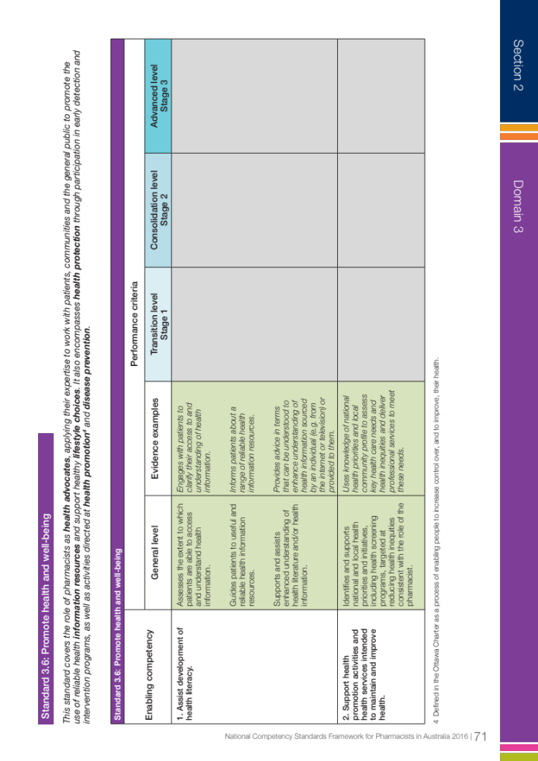
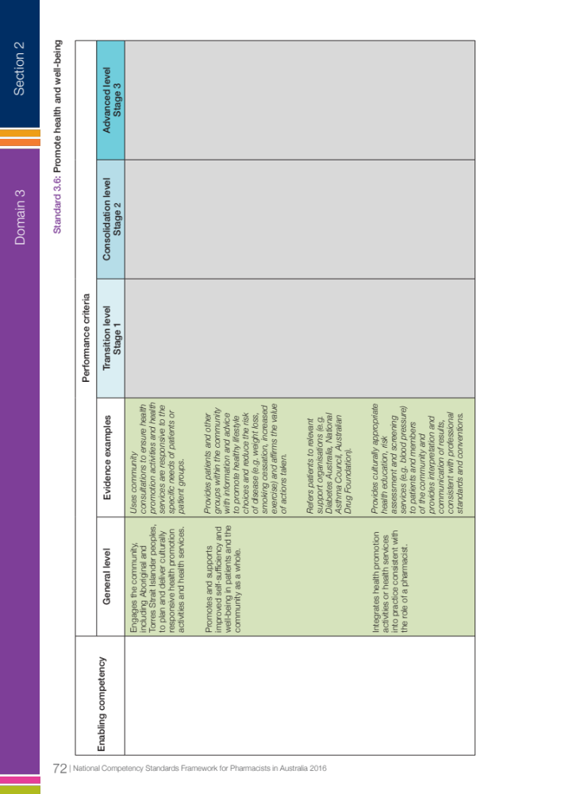
2. Each of the Enabling Competencies is associated with a number of Performance Criteria. These are the behaviours that would be observed if you are competent.
1. Each Competency Standard consists of a number of Enabling Competencies.
4. As you progress through your career towards advanced levels of performance, the level of performance expected of you may increase.
Performance criteria fields which are intended to be unused are shaded in grey.
3. General level performance criteria are described for those behaviours expected at initial registration and the time prior to progressing towards advanced levels of performance.
5. Evidence examples are provided only for those performance criteria at General level, to assist users to understand the intent of the performance criteria.
Note: they are only examples. You may have other examples of evidence that are more relevant to your role and the services you provide.
Notes:
Each Competency Standard consists of a number of Enabling Competencies
Each of the Enabling Competencies is associated with a number of Performance Criteria. These are the behaviours that would be observed if you are competent.
General level performance criteria are described for those behaviours expected at initial registration and the time prior to progressing towards advanced levels of performance.
As you progress through your career towards advanced levels of performance, the level of performance expected of you may increase:
Sometimes the performance criteria for these advanced levels of performance have been described (consistent with the 2012 Advanced Pharmacy Practice Framework).
Sometimes the performance criteria may be identical across a number of performance levels.
Evidence examples are provided only for those performance criteria at General level, to assist users to understand the intent of the performance criteria.
Note: they are only examples. You may have other examples of evidence that are more relevant to your role and the services you provide.
[Each call out box on the slide should appear only when each is spoken]

Slide 17
1. Each Competency Standard consists of a number of Enabling Competencies.
Notes:
Each Competency Standard consists of a number of Enabling Competencies

Slide 18
2. Each of the Enabling Competencies is associated with a number of Performance Criteria. These are the behaviours that would be observed if you are competent.
Notes:
2. Each of the Enabling Competencies is associated with a number of Performance Criteria. These are the behaviours that would be observed if you are competent.

Slide 19
3. General level performance criteria are described for those behaviours expected at initial registration and the time prior to progressing towards advanced levels of performance.
Notes:
3. General level performance criteria are described for those behaviours expected at initial registration and the time prior to progressing towards advanced levels of performance.

Slide 20
4. As you progress through your career towards advanced levels of performance, the level of performance expected of you may increase.
Performance criteria fields which are intended to be unused are shaded in grey.
Notes:
4. As you progress through your career towards advanced levels of performance, the level of performance expected of you may increase:
Sometimes the performance criteria for these advanced levels of performance have been described (consistent with the 2012 Advanced Pharmacy Practice Framework).
Sometimes the performance criteria may be identical across a number of performance levels.

Slide 21
5. Evidence examples are provided only for those performance criteria at General level, to assist users to understand the intent of the performance criteria.
Note: they are only examples. You may have other examples of evidence that are more relevant to your role and the services you provide.
Notes:
5. Evidence examples are provided only for those performance criteria at General level, to assist users to understand the intent of the performance criteria.
Note: they are only examples. You may have other examples of evidence that are more relevant to your role and the services you provide.

Slide 22
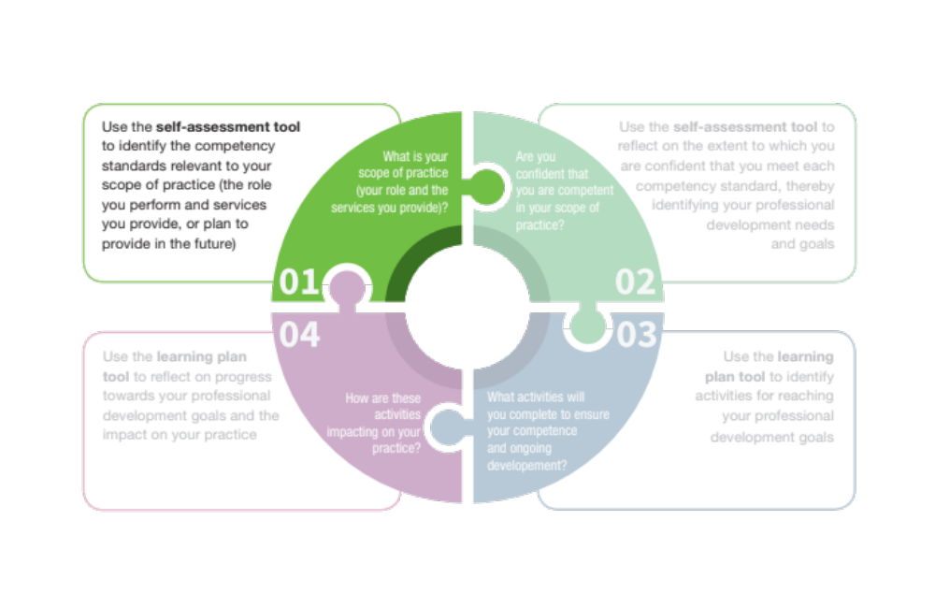
Identify the competency standards relevant to your scope of practice (continued)
Domain 1.
Professionalism and ethics
Universally applicable
Self assessment
Step 1
Domain 2.
Communication and collaboration
Also
Domain 3.
Medicines management and patient care
Domain 4.
Leadership and management
Also
Domain 5.
Education and research
Notes:
Work through the competency standards in each Domain from the Framework.
Some competency standards apply to all pharmacists. These are in the domains of Professionalism and Ethics, Communication and Collaboration, and some of the ones in the domain Leadership and Management.
For those that don’t apply to all pharmacists, you will need to identify whether they are relevant to your current scope of practice, or relevant to a role you plan to perform or service you plan to provide in the future.
Your profile can capture all of the roles you hold and settings in which you practice.

Slide 23




Self assessment
Step 2
Self-assess whether development is required to identify your professional development needs and goals
Notes:
The second step is to self-assess whether development is required in order to identify your professional development needs and goals

Slide 24
For your current scope or future roles/services you are planning…
Development is not required
How am I sure?
Ongoing development is required for current scope
Was there a challenging situation where I could have performed better?
Has an incident related to this occurred recently?
Has there been feedback about this from my patients or peers?
Do I just not feel I have the required skills?
In what way?
How do I keep up to date with the latest evidence in this area? How do I maintain my knowledge and skills in this area? Do I have a system in place to make sure I implement the latest evidence in this area into my practice? What recent examples are there of me doing this?
Who is affected by whether I meet this standard or not? Have I had confirmation or recognition from them that I do meet this standard? For example, have I been through a process of peer review or surveyed my patients?
Development required for future/ planned scope
In what way?
Notes:
Reflect on the extent to which you are confident that you meet each competency standard relevant to your scope of practice.
You will need to refer to the full 2016 National Competency Standards Framework for Pharmacists in Australia for context and guidance.
For all competency standards that are relevant to your scope of practice, or to future roles or services you plan to provide, identify whether:
Development is not required
Ongoing development is required for my current scope
Development is required for future or planned scope.
If you select that development is not required, ask yourself ‘how am I sure?’ This might include asking yourself:
How do I keep up to date with the latest evidence in this area? How do I maintain my knowledge and skills in this area? Do I have a system in place to make sure I implement the latest evidence in this area into my practice? What recent examples are there of me doing this?
Who is affected by whether I meet this standard or not? Have I had confirmation or recognition from them that I do meet this standard? For example, have I been through a process of peer review or surveyed my patients?
If you select that ongoing development is required for your current scope, ask yourself ‘in what way?’ This might include asking yourself:
Was there a challenging situation where I could have performed better?
Has an incident related to this occurred recently?
Has there been feedback about this from my patients or peers?
Do I just not feel that I have the required skills?
Make brief notes to explain why you assessed that development was required.

Slide 25
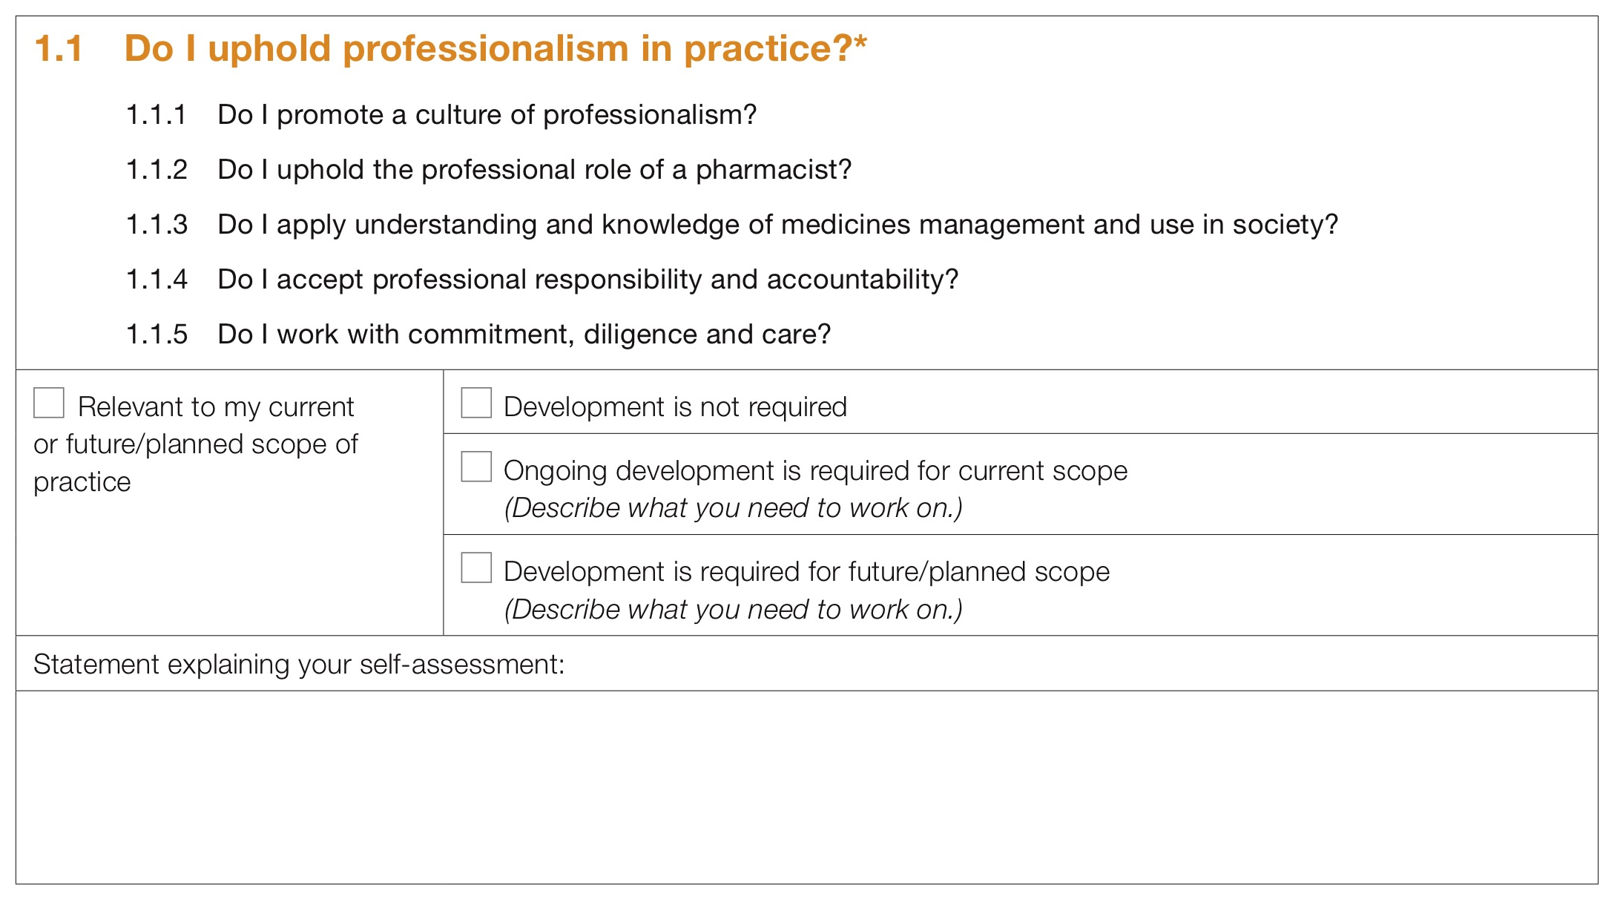

An example of documentation
This example relates to competency standard 1.1
These are the Enabling Competencies. You will need to refer to the full document to review the Performance Criteria (the behaviours that would be observed if you are competent)
You then need to determine whether development is or isn’t required. If development is required, make brief notes to describe what you need to work on.
As this competency standard applies to all pharmacists, it has been pre-selected in the self-assessment tool
Notes:
The Self-assessment tool guides you to document your self assessment.
This example is for a competency standard that is applicable to all pharmacists in all scopes of practice.
It relates to competency standard 1.1
The Enabling competencies are listed. However you will need to use the 2016 Framework to review the Performance Criteria and Evidence Examples
The tool has pre-selected that this competency is relevant to your scope of practice.
You just need to reflect on whether development is or isn’t required, in relation to both your current scope and any future scope. If development is required, make brief notes to explain in what way. This will help you when you get to the next stage – developing professional development goals and identifying activities that will help you meet those goals.

Slide 26
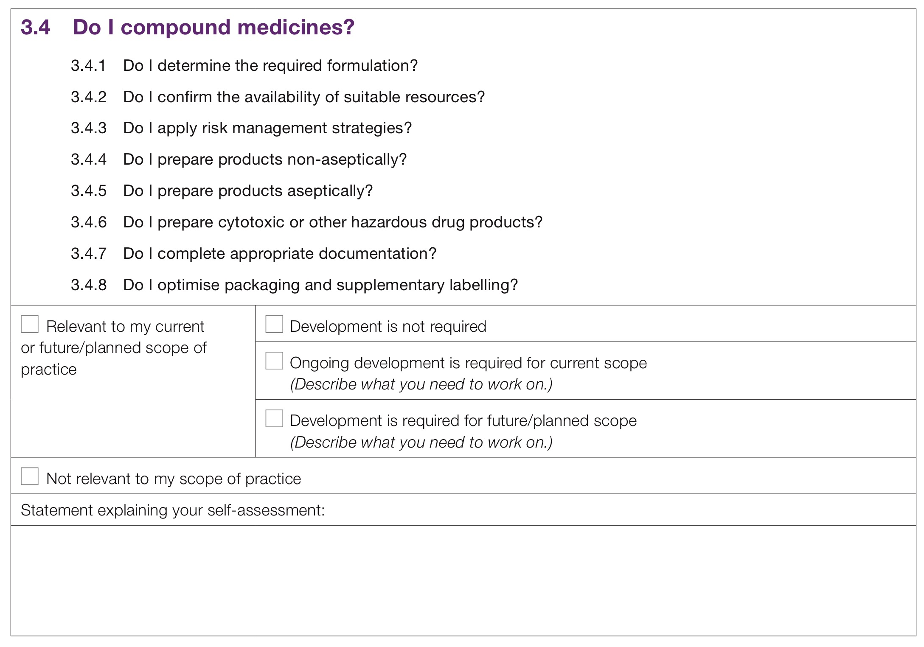
This example relates to competency standard 3.4
These are the Enabling Competencies. You will need to refer to the full document to review the Performance Criteria (the behaviours that would be observed if you are competent)
For those relevant to current or future scopes, you then need to select whether development is or isn’t required. If development is required, make brief notes to describe what you need to work on.
Select whether it is or isn’t relevant to your current or future scope of practice=
Notes:
This example is for a competency standard that you will need to decide whether it is or isn’t relevant to your current or future scope of practice.
It is important not to think of this as a ‘tick box’ exercise. When you are considering a competency standard, you must think about it in the context of your scope of practice. Sometimes not all enabling competencies may be relevant to you.
For example, in this case:
You may compound products non-aseptically (enabling competency 3.4.4) but not aseptically (enabling competency 3.4.5).
You would still select that the competency standard 3.4 is relevant to your scope of practice
However you would only consider whether development was required around enabling competency 3.4.5 if you were planning to start compounding products aseptically as part of a new role or service.

Slide 27
Case examples available
You can download the completed self-assessments
for Mary, Aron, Sierra and Lee
Notes:
For the four pharmacists introduced earlier, Mary, Aron, Sierra and Lee, you can download completed self-assessments. These provide examples of how pharmacists with different scopes of practice might complete the self-assessment, but should not be used to limit how you use it yourself.
We will have a more detailed look at Mary’s here.

Slide 28
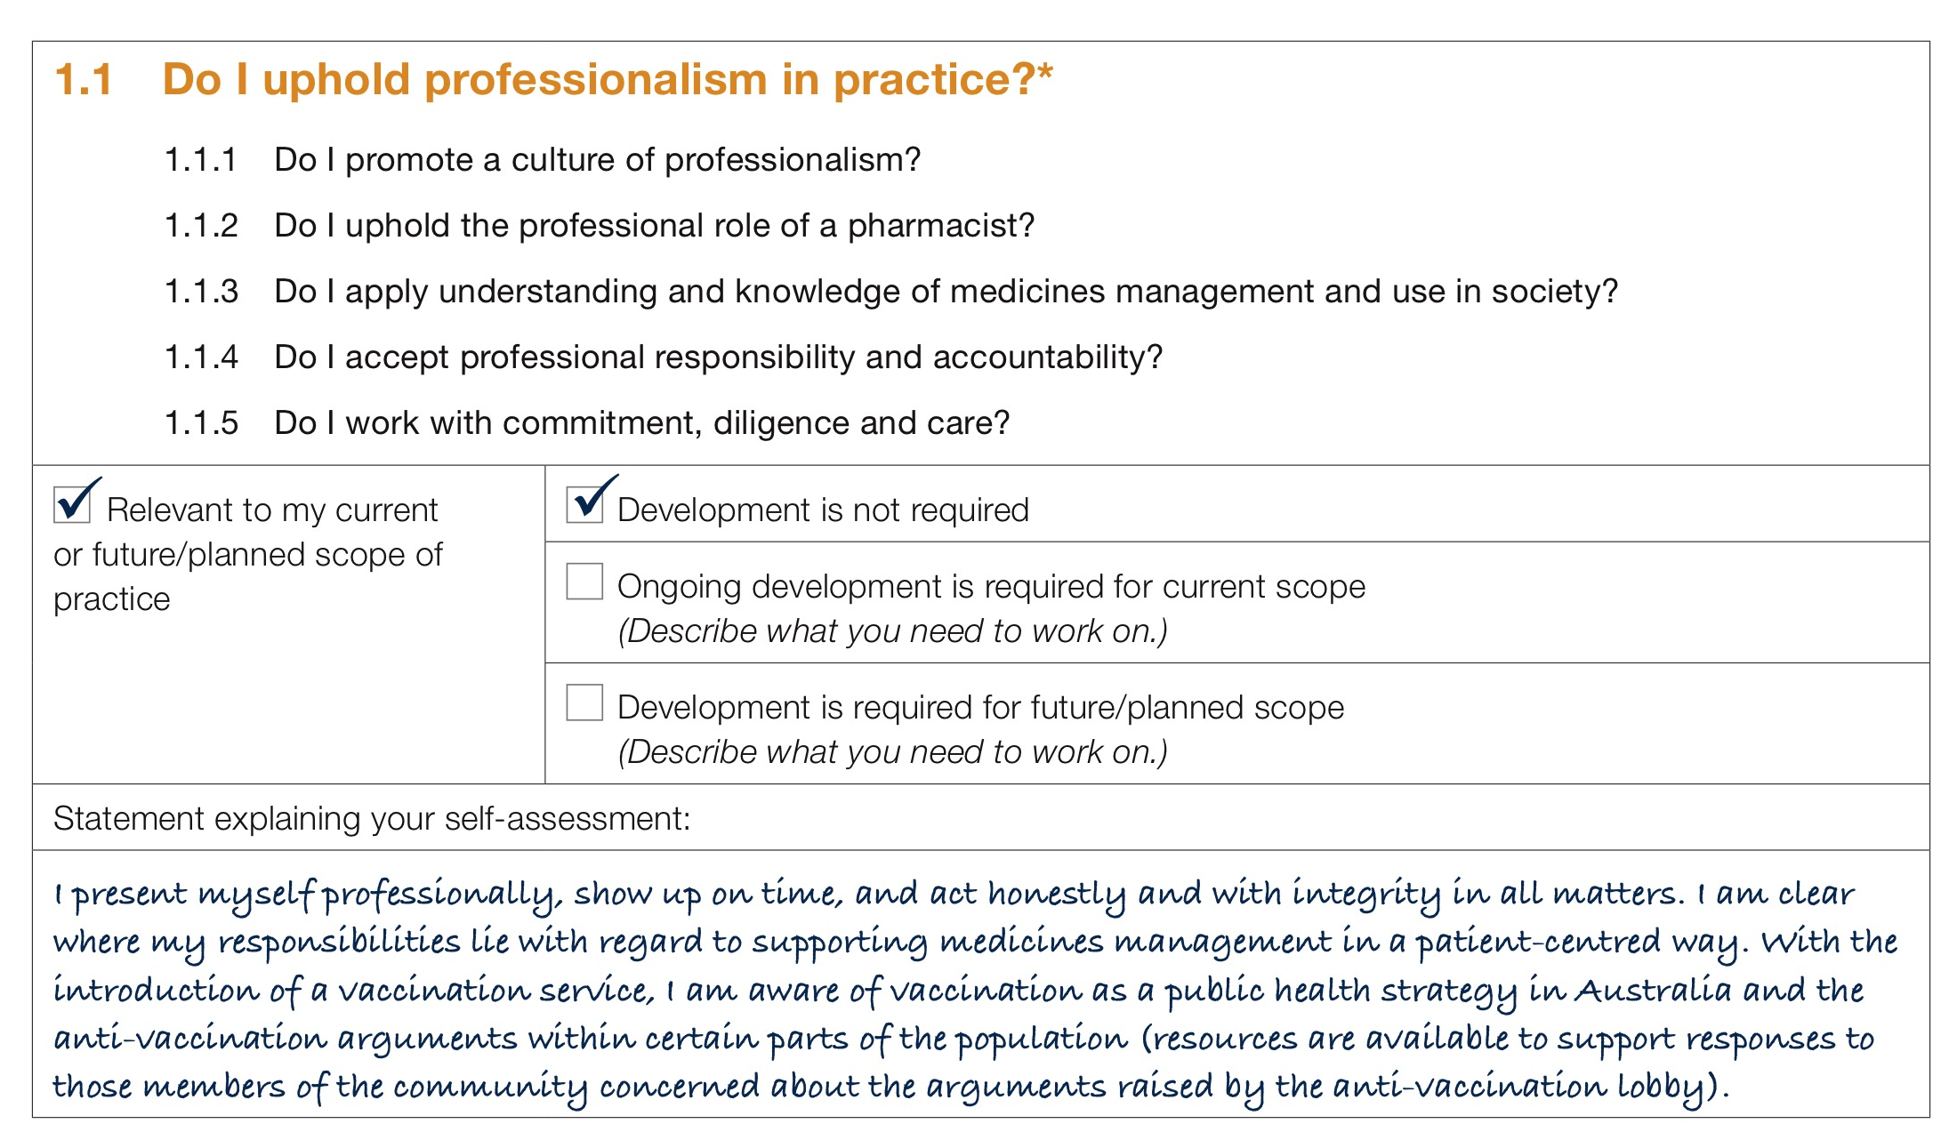
Case 1 - Mary
Notes:
Her ongoing development needs primarily relate to the upcoming introduction of a vaccination service in the pharmacy.
Let’s see how this is reflected in some of the competency standards in her self-assessment.
One of the enabling competencies for competency standard 1.1 requires an understanding of the use of medicines in society. In relation to a vaccination service, it would be important for pharmacists to understand the myths believed by some people in our society around vaccination so that they can respond when confronted with anti-vaccination arguments.
Mary identifies this, but notes that this is an awareness she already holds from existing efforts to promote vaccination.
She therefore selects that development is not required.

Slide 29
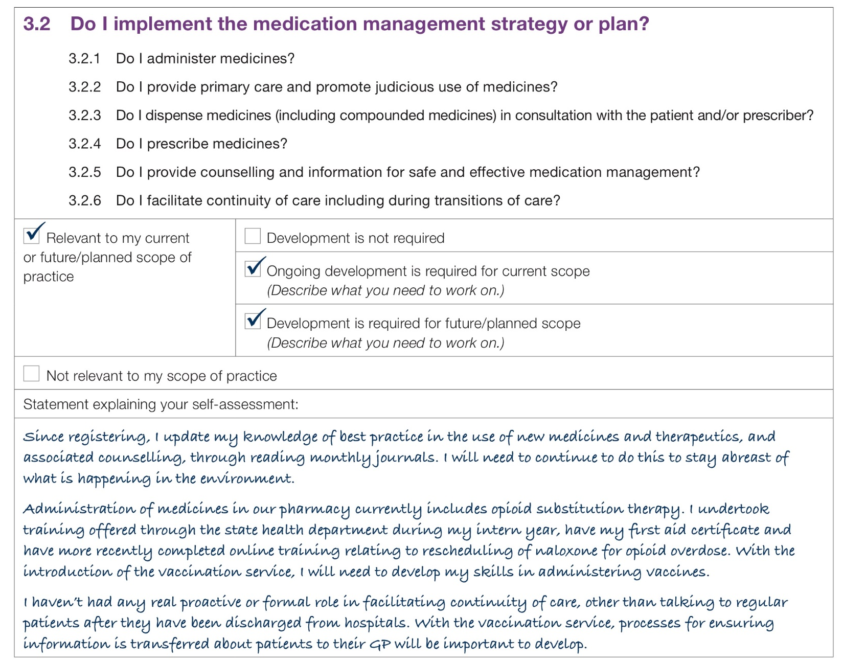
Case 1 - Mary
Notes:
Against Competency Standard 3.2, Mary notes her need to upskill clinically in administering medicines to support her role in the vaccination service that will be introduced.
However, she also notes that she has an ongoing need to maintain her knowledge of the latest evidence and best practice for all medicines dispensed and supplied through her pharmacy, associated therapeutics and environmental changes.
She therefore selects both that ongoing development is required for her current scope, and that it is required for her future/planned scope.

Slide 30
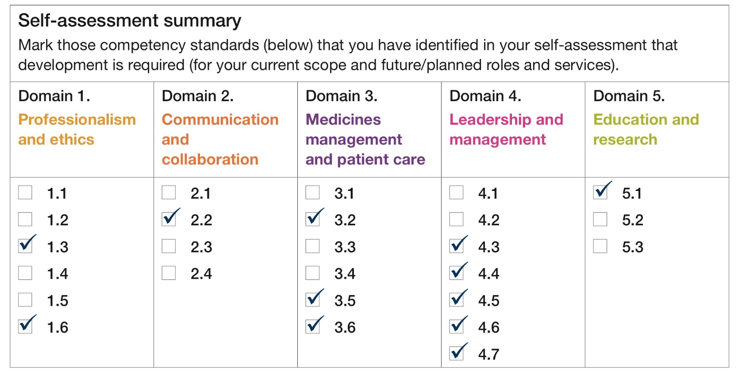
Case 1 - Mary
Notes:
Once Mary has been through all the competency standards, and self-assessed whether development is or isn’t required, she can collate these on the final page of her self-assessment tool, as is shown here.
This ‘helicopter view’ of her self-assessment will help her to identify her professional development goals.

Slide 31
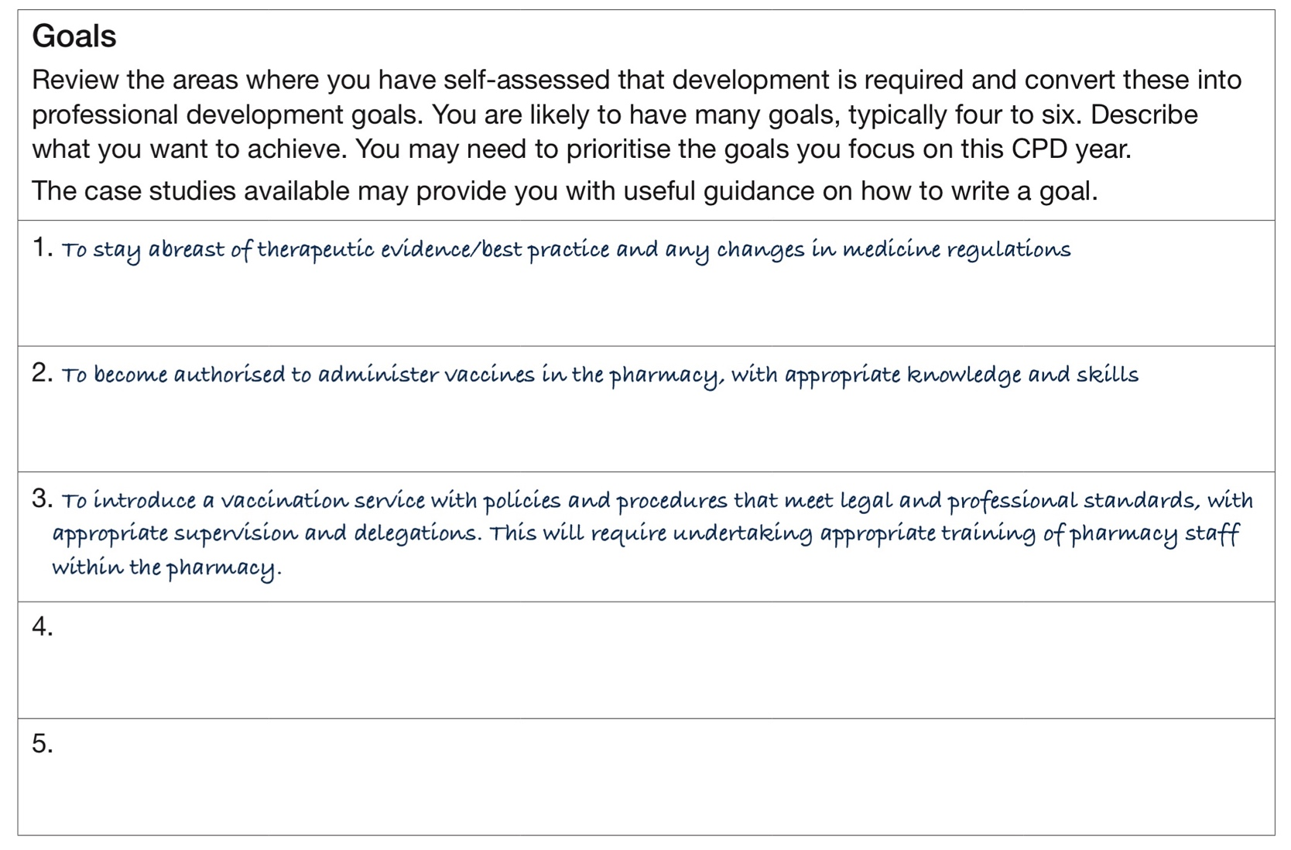
Case 1 - Mary
Notes:
Each goal is likely to incorporate competency standards from a number of Domains.
You may have one or many. You may need to prioritise the goals you focus on this CPD year.
Sometimes, breaking a big goal into several smaller goals can help you to progress more effectively to achieving your goal.
When Mary looks across her completed self-assessment, she develops the goals shown here as her main priorities to focus on this year.
Mary can now move forward with developing her Learning Plan.

Slide 32
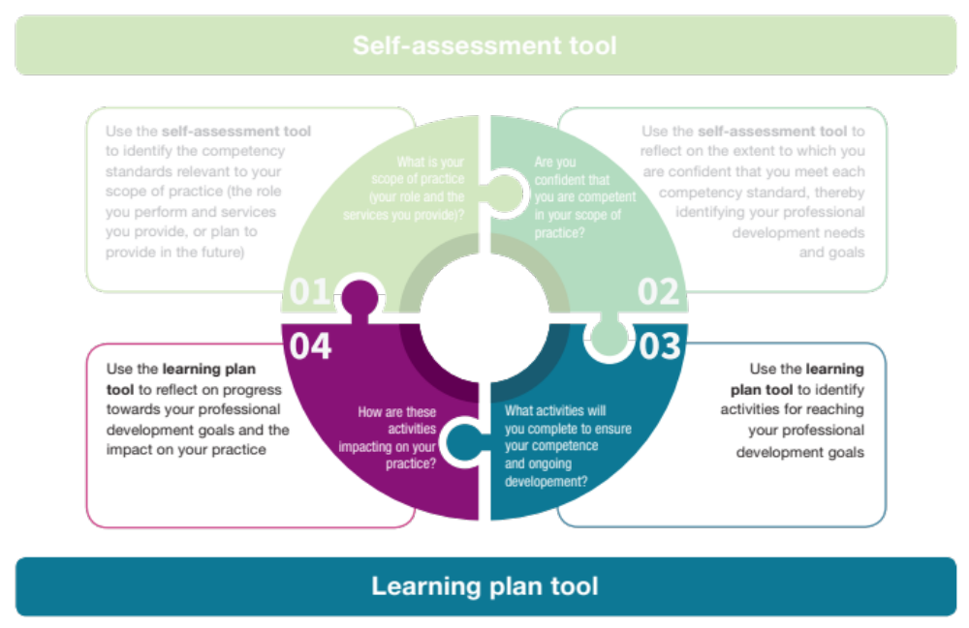
The process
Notes:
That is the first part of the process complete.
Once you have finished the self-assessment and identified some professional development goals, you then move on to the learning plan tool.
The learning plan tool can help you to:
Identify activities for reaching your professional development goals
Then reflect on progress towards your professional development goals and the impact on your practice
These are steps 3 and 4 in the process.

Slide 33
Learning plan
Step 3
Identify the activities you can take to reach your goal
Examples include:
education programs
conferences
multimedia or website-based programs
Notes:
Step 3 involves identifying the activities you can take to reach your goal
There are many different activities you can take to reach goals, and sometimes you may need to take a number of different activities to achieve one goal.
Examples of actions include:
education programs
seminars
workshops
lectures
conferences
discussion groups
multimedia or website-based programs
research and preparation for the publication of an article in a peer-reviewed journal
review of professional journals and reference texts

Slide 34
Learning plan
Step 4
Reflect on progress towards or achievement of your goal
Notes:
Step 4 involves reflecting on progress towards or achievement of your goal.
After you complete each activity, reflect on how it has helped achieve this goal and impacted on your practice.
Confirm which competency standards have been met with this activity.
Document the CPD Credits that you have achieved with this activity.
You may not need to complete all identified activities to reach your goal, if one activity sufficiently meets your needs. Alternatively, you may need to identify new activities to take to reach your goal if those you have completed have not sufficiently met all your needs.
For the four pharmacists introduced earlier, Mary, Aron, Sierra and Lee, you can download completed learning plans. Remember these are just examples of how pharmacists with different scopes of practice might complete the learning plan, and should not be used to limit how you use it yourself.
We will have a more detailed look at Mary’s here. She is the community pharmacist who plans to introduce a vaccination service.

Slide 35
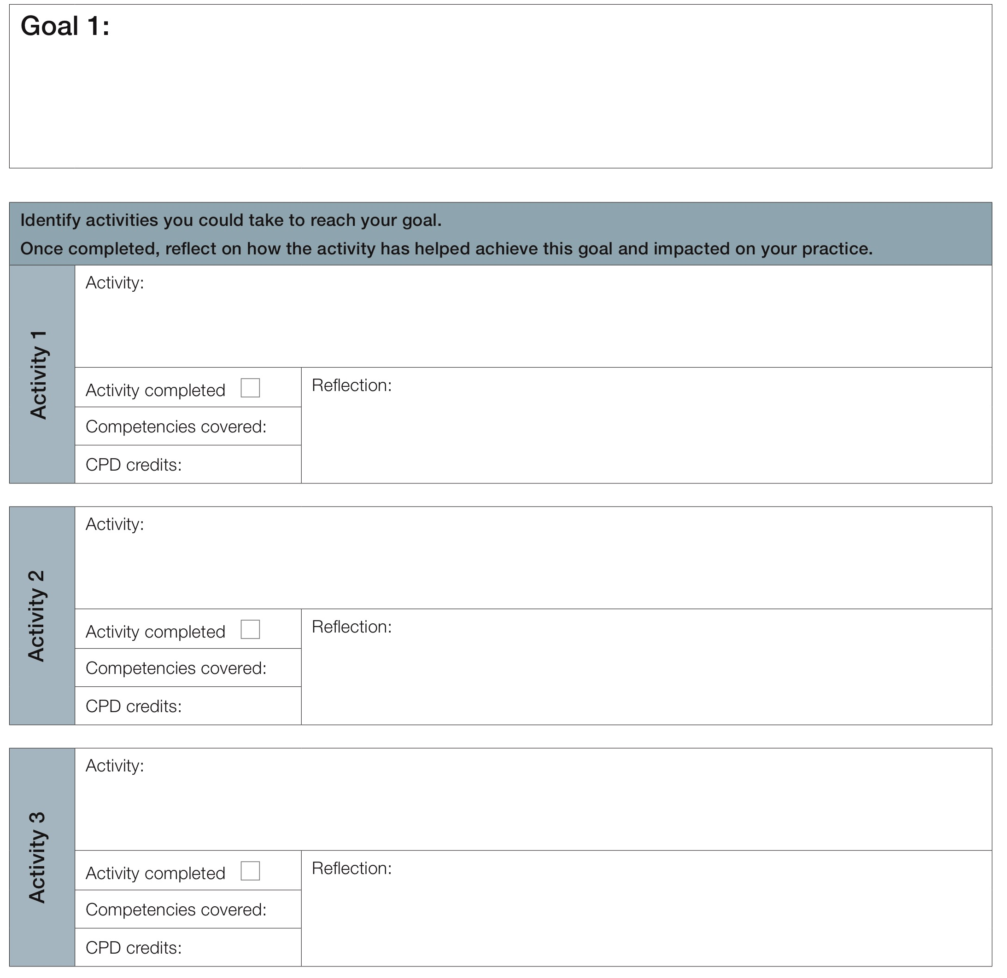
[Describe what you want to achieve; transfer this from your self-assessment tool]
Your goal will come from your self-assessment.
One goal will often cover competency standards from a number of Domains
[Describe the activity, including who, what, where and when, as relevant]
[Describe how the activity has helped achieve this goal and impacted on your practice]
[Describe the activity, including who, what, where and when, as relevant]
Many activities can contribute to you reaching your goal. After completing an activity, reflect on how it has impacted on your practice and whether it has helped achieve your goal
[Describe how the activity has helped achieve this goal and impacted on your practice]
[Describe the activity, including who, what, where and when, as relevant]
[Describe how the activity has helped achieve this goal and impacted on your practice]
Notes:
Your documentation for each goal will look like this.
Your goal will come from your self-assessment. One goal will often cover competency standards from a number of Domains.
Many activities can contribute to you reaching your goal. After completing an activity, reflect on how it has impacted on your practice and whether it has helped achieve your goal.

Slide 36
Case 1 - Mary
Notes:
Remember Mary’s goals

Slide 37
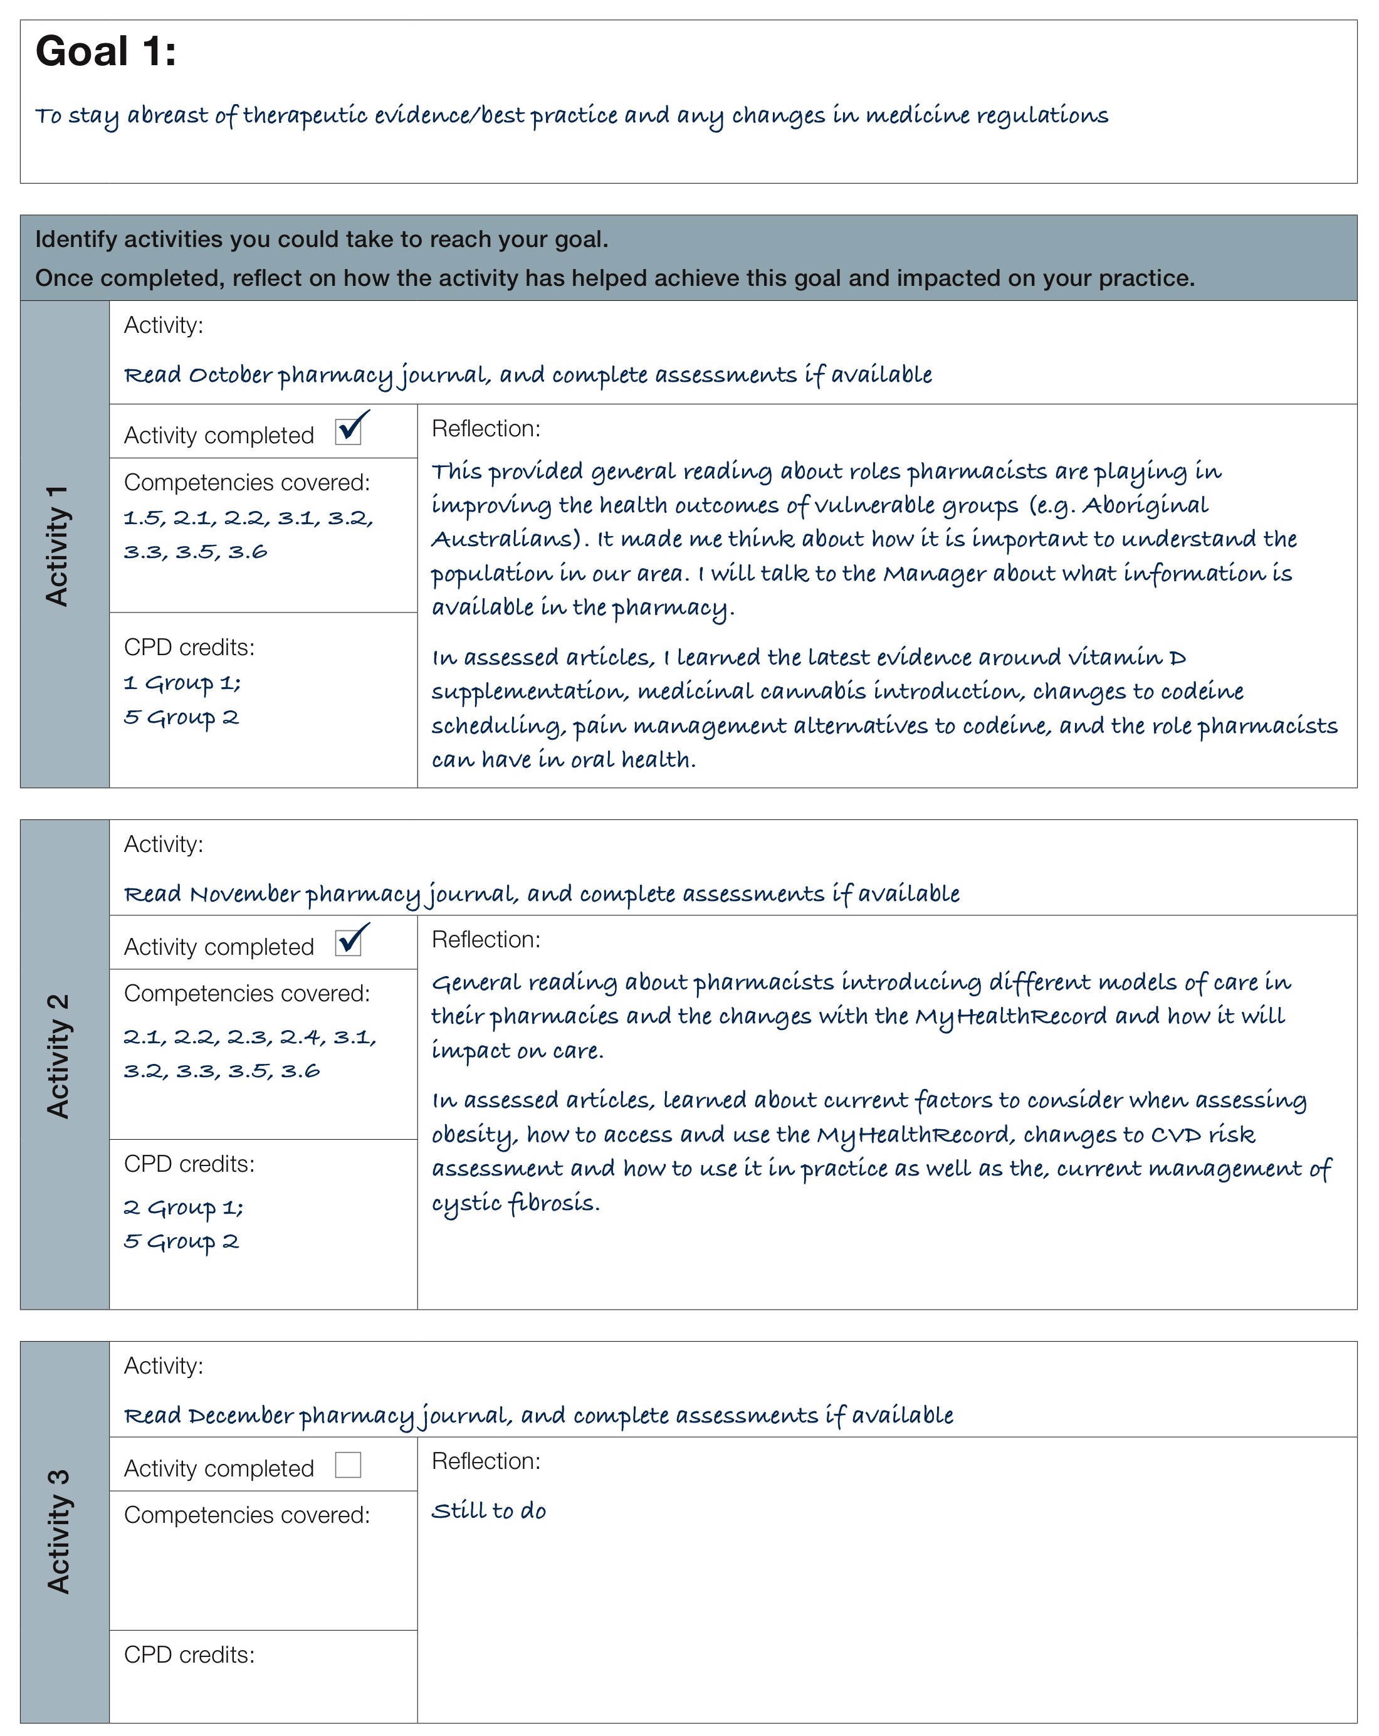
Notes:
In order to stay abreast of therapeutic evidence, best practice and changes in regulations, she has identified some regular activities to help her do this.
It is important (and a requirement of the CPD registration standard) that you reflect on each activity. You may reflect that the activity has positively impacted on your practice. Or you may reflect that it hasn’t, and therefore need to identify and pursue other activities. You may also identify other learning needs when you reflect on the activity.

Slide 38
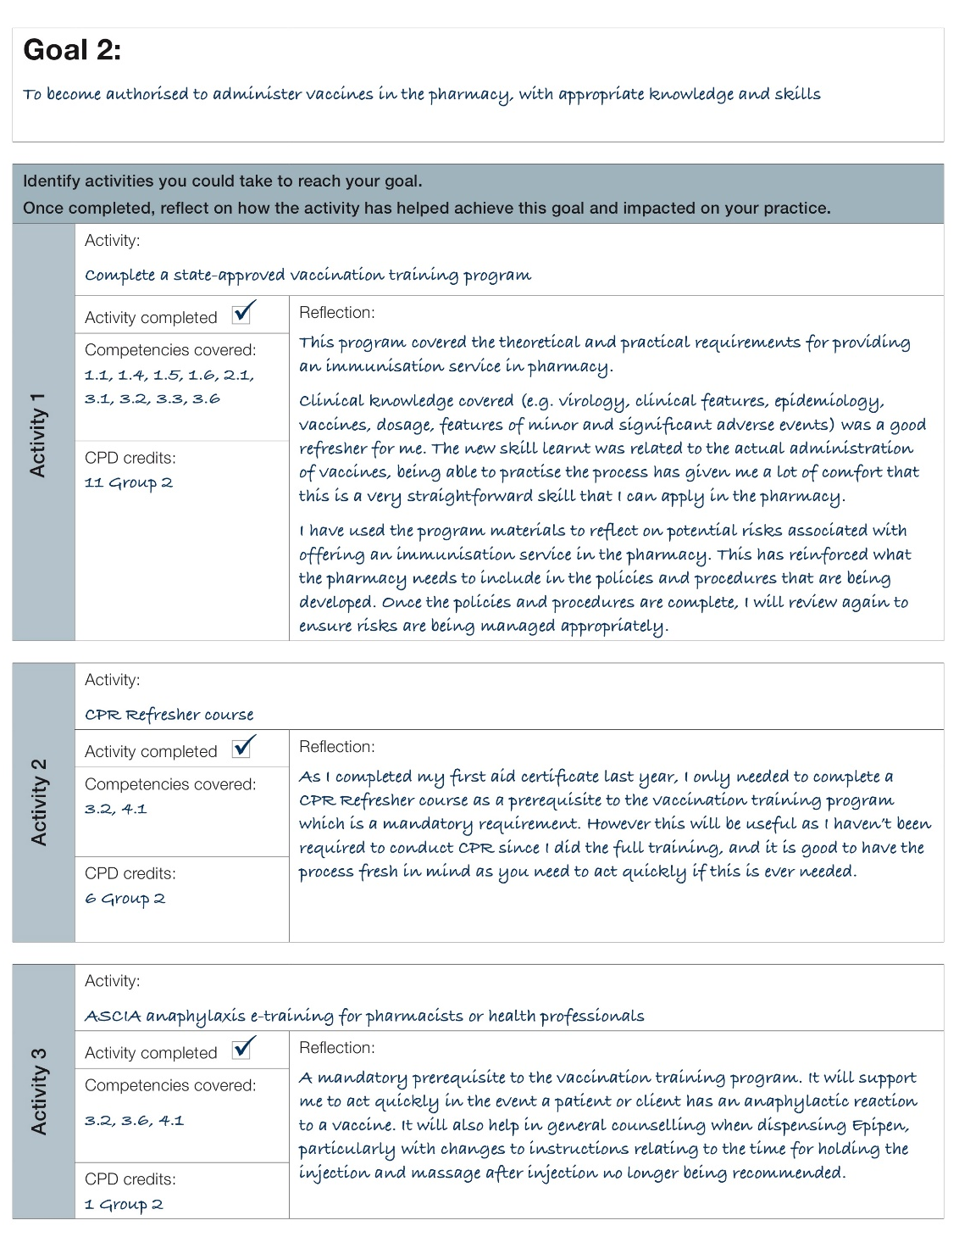
Notes:
To achieve her goal of becoming authorised to administer vaccines, Mary has identified 3 activities she needs to do:
To complete a state-approved vaccination training program
To complete a CPR Refresher course
To complete the ASCIA anaphylaxis e-training for pharmacists
She has reflected on their value, not just as a mandatory requirement to become authorised, but also how they will impact her practice.

Slide 39
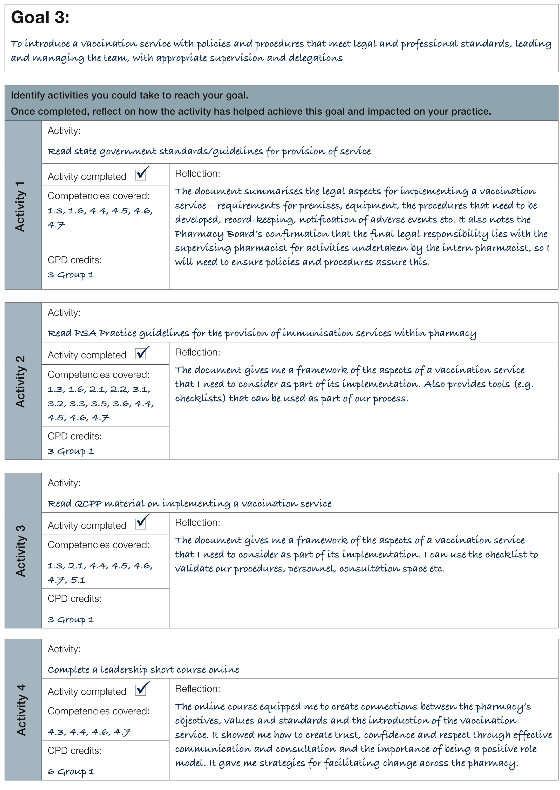
Notes:
Mary also has a goal related to introducing the vaccination service – a goal that goes beyond just becoming authorised to administer vaccines.
Her activities focus on becoming familiar with government and professional guidelines and resources that support the implementation of such a service. Her reflection on these activities include how she will use the resources she has found.
Beyond the service-specific aspects of this goal, she also identifies that leadership training would be valuable.

Slide 40

Your next steps
If you wish to use these tools, you will need:
A copy of the 2016 National Competency Standards Framework for Pharmacists in Australia
Self-assessment tool
Learning plan tool
For more support:
Refer to the case studies
Detailed presentation on each of
the tools
A professional association
Notes:
If you wish to start using these tools yourself, have accessible:
A copy of the 2016 National Competency Standards Framework for Pharmacists in Australia;
The Self-assessment tool; and
The Learning plan tool.
For the pharmacists in the case studies we looked at through this presentation, there are completed self-assessment and learning plan tools available for you to review as well.
You can also review the more detailed presentations on using the Self-assessment tool and the Learning plan tool, and get further support from a professional association.

Slide 41
“Learning experiences are like journeys. The journey starts where the learning is now, and ends when the learner is successful. The end of the journey isn’t knowing more, it’s doing more.”
Julie Dirksen, learning strategy and design consultant
Notes:
Remember ‘Learning experiences are like journeys. The journey starts where the learning is now, and ends when the learner is successful. The end of the journey isn’t knowing more, it’s doing more.’
The CPD Registration Standard requires that you go through this process of self-assessment and developing a learning plan on an annual basis. However, you can also do more often as you think necessary. And if your scope of practice changes between these times, you may also find it worthwhile going through this process again.

Slide 42
Your professional responsibility
To practise safely and effectively, with the care of patients or clients their first concern
A lifelong commitment to:
  recognising and working within the limits of their competence and scope of practice
  keeping their skills and knowledge up-to-date
  reflecting regularly on whether they are practising effectively
  refining and developing their judgement as they gain experience
  when moving into a new area of practice, ensuring they have achieved competency in that area
Code of conduct for registered health practitioners. Pharmacy Board of Australia; 2010
Notes:
Community expectations are that you, and all health practitioners, practise safely and effectively, with the care of patients or clients your first concern. The community expects that you:
recognise and work within the limits of your competence and scope of practice;
keep your skills and knowledge up-to-date;
reflect regularly on whether you are practising effectively;
refine and develop your judgement as you gain experience; and
when moving into a new area of practice, ensure you have achieved competency in that area.
These tools are to help you in meeting this responsibility.
Reference: Code of conduct for registered health practitioners. Pharmacy Board of Australia; 2010.

